Slide 1
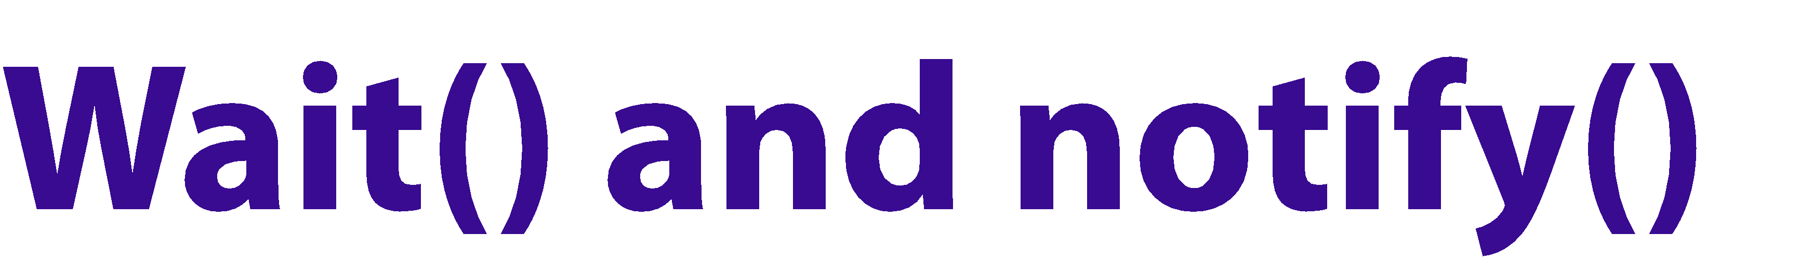
When the notify() method of an object is called, then a single waiting thread on that object is signaled to get ready to resume execution.
After our Producer thread exits insertValue and releases the lock, our Consumer thread gets the lock once again and resumes its execution.

Slide 2
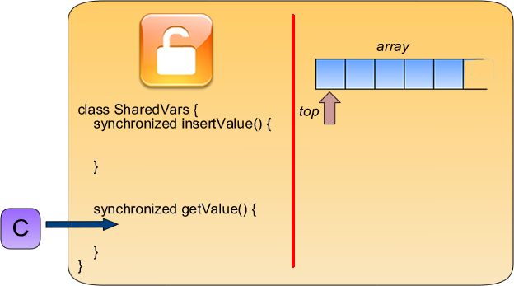

Slide 3
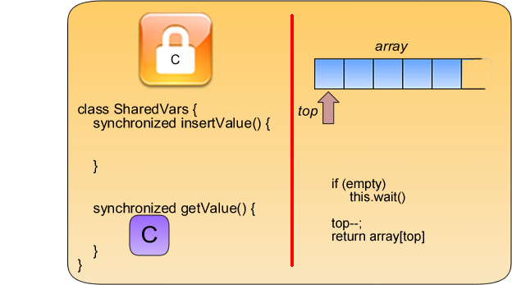

Slide 4
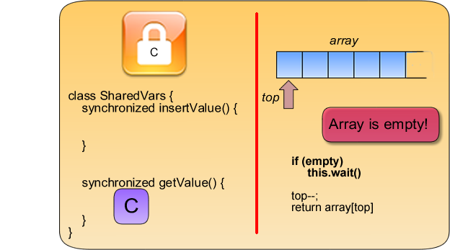

Slide 5
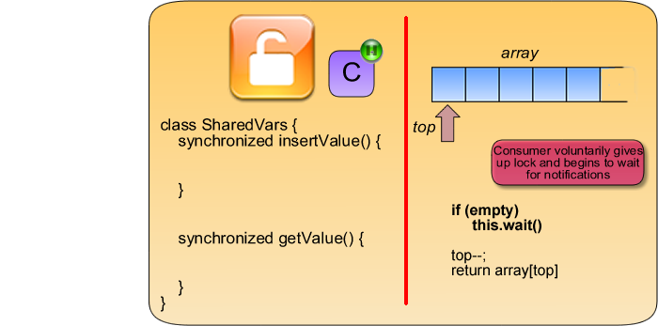

Slide 6
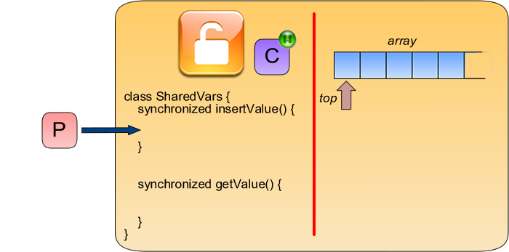

Slide 7
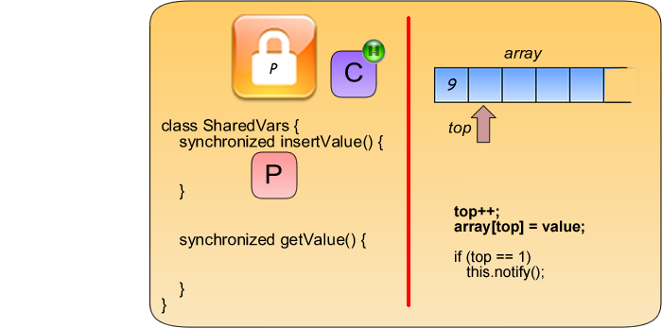

Slide 8
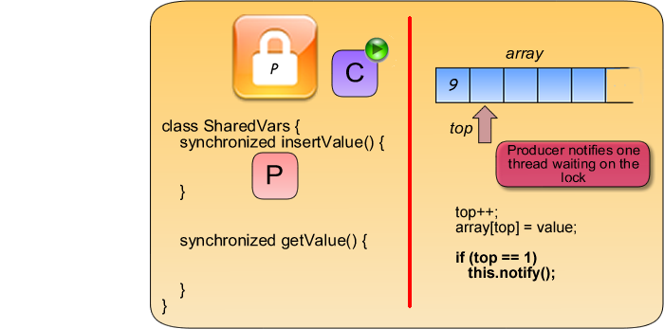

Slide 9
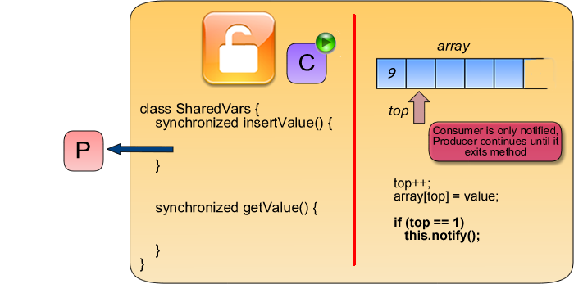

Slide 10
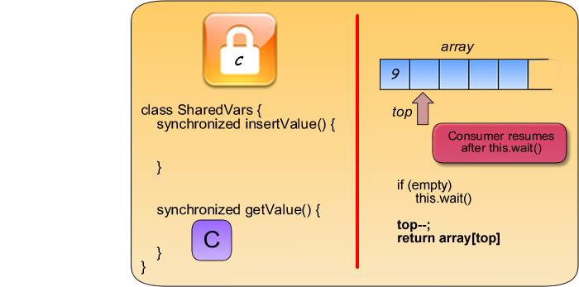

Slide 11
Another method called notifyAll() notifies all the waiting threads.
These waiting threads would then compete to see which single thread resumes execution, the rest of the threads would once again wait.

Slide 12



If you run the demo program again, you can see that, even if the producer is slow, the consumer waits until the producer gives out a value before getting that value
Note that you must also consider inserting on a full array
Producer must wait until consumer has taken away some values
before inserting
We will leave the implementation of this as an exercise

Slide 13
Note that this same thing must occur on inserting on a full array
Producer must wait until consumer has taken away some values before inserting
We will leave the implementation of this as an exercise.

Slide 14


Slide 15
Alice and Bob are at the office. There is a doorway that they have to pass through every now and then. Since Bob has good manners, if he gets to the door, he always makes sure that he always opens the door and waits for Alice to go through before he does. Alice by herself simply goes through the door.
Your task is to write an Alice and Bob thread that mimics this behavior. To simulate having to pass through the door, have a delay in each thread for a random amount of time, maximum of 5 seconds. The output of your code should look something like this:
Alice: I go through the door Alice: I go through the door
Bob: I get to the door and wait for Alice...
Alice: I go through the door
Bob: I follow Alice
Alice: I go through the door
Bob: I get to the door and wait for Alice

